Slide 1






Welcome!
Institutions and Individuals Need Effective Decentralized Privacy Solutions

Slide 2


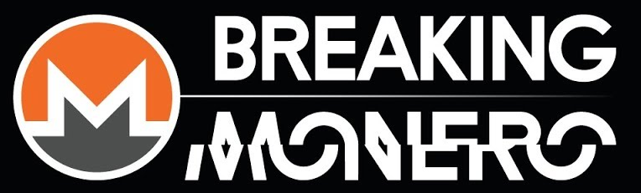
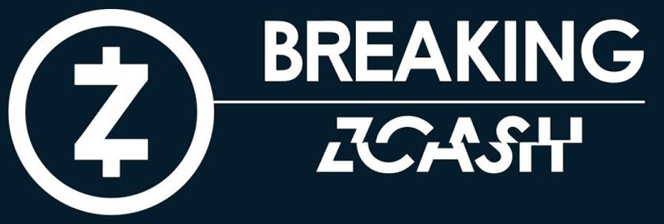



Super Quick Intro
Title | Organization
Regulatory Compliance Analyst | DV Chain dvtrading.co/dv-chain
Organizer | Monero Community Workgroup #monero-community
Board Member | MAGIC magicgrants.org
Host and Researcher | Breaking Monero Breaking Zcash
Publisher | Mastering Monero masteringmonero.com
Moderator | r/CryptoCurrency reddit.com/r/cryptocurrency
Former President | Minnesota Cryptocurrency mncryptocurrency.org
innesota Cryptocurrency

Slide 3

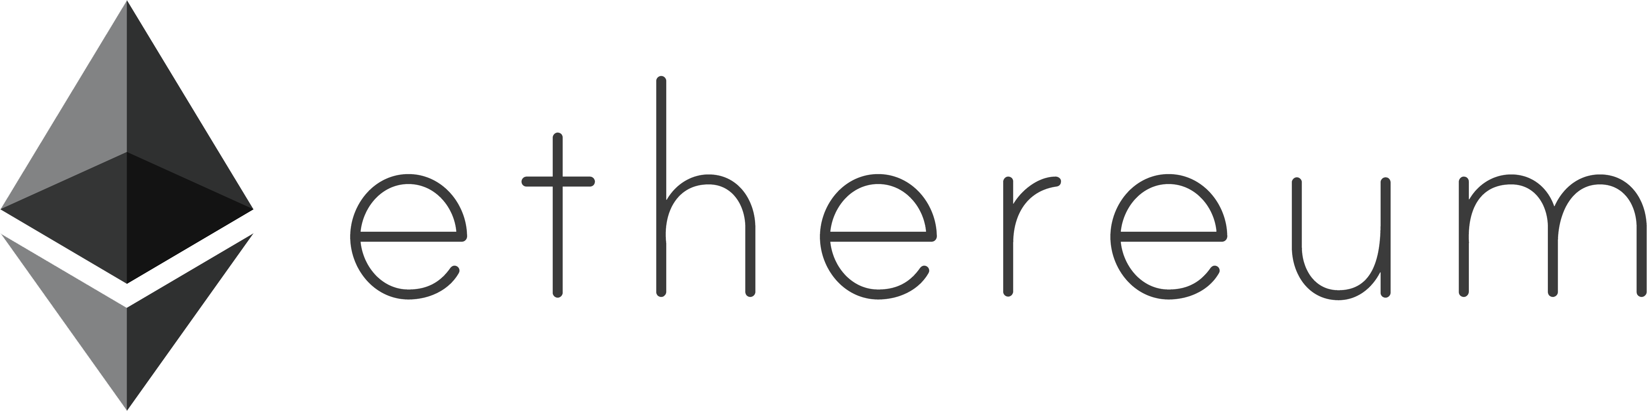
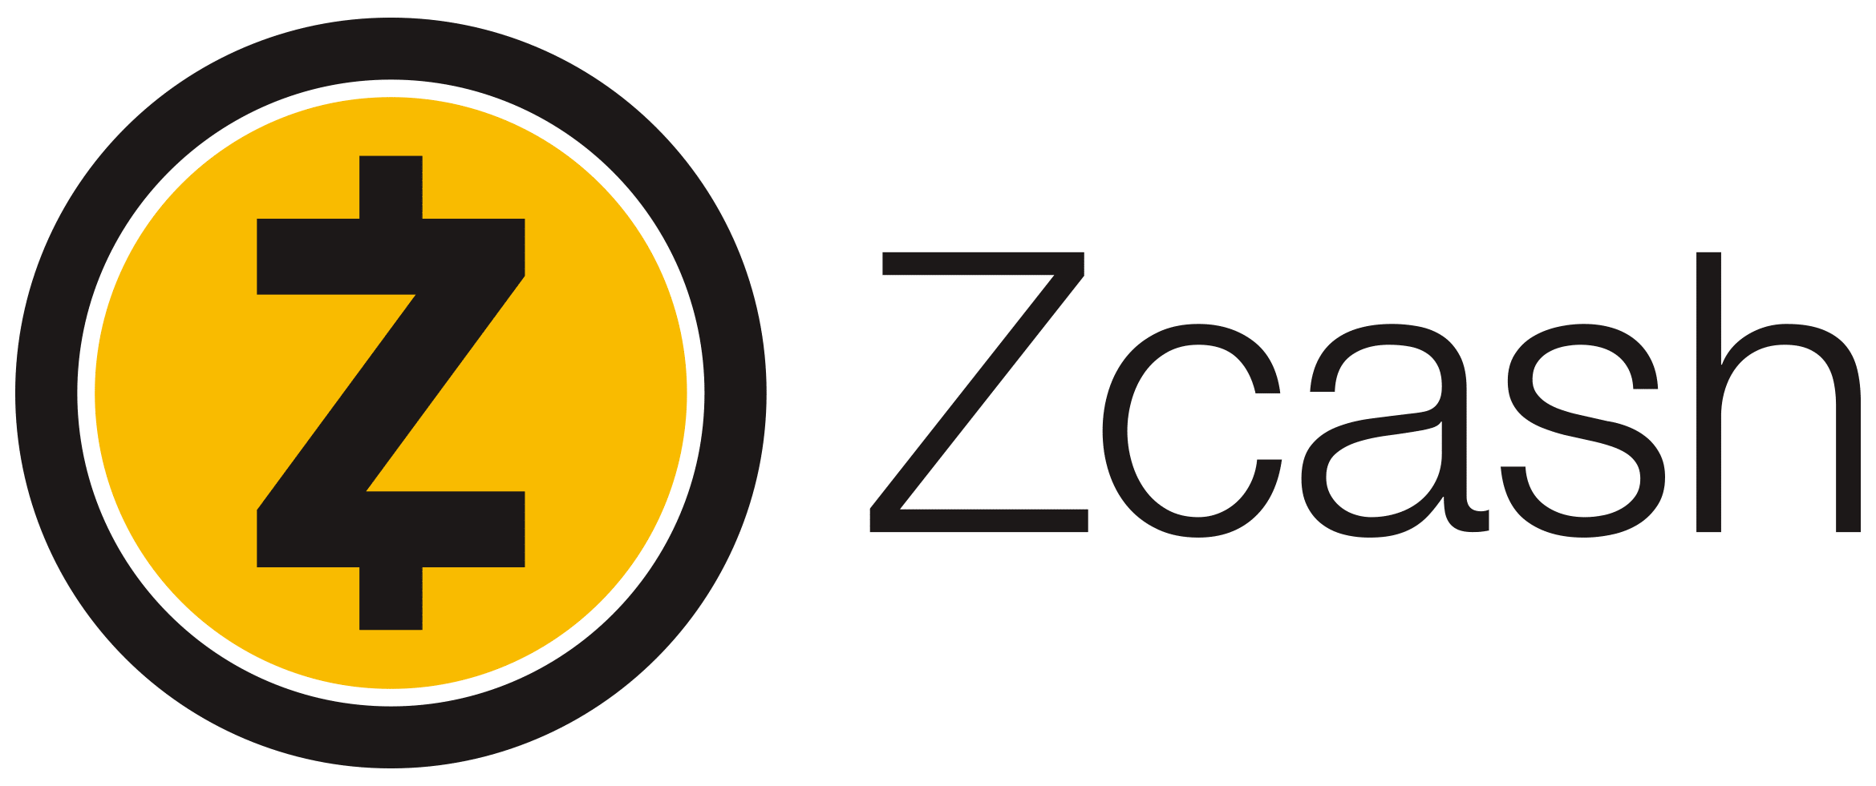

Quick Definition Quadrant
 | Transparent | Obfuscated
Public
Private | Private Bitcoin/Ethereum Instance | Private Monero/Zcash Instance
Note: obfuscated is an oversimplification, which I will cover later in this talk

Slide 4
Activity
Name

Slide 5
Activity
Name to Alice

Slide 6
Activity
Name to Alice
Alice to Bob

Slide 7
Activity
Name to Alice
Alice to Bob
Bob to Charlie

Slide 8
Activity
Name to Alice
Alice to Bob
Bob to Charlie

Slide 9
Activity Debrief
Who accepted cards with red dots on them? Why?
Who could not send their funds to anyone else?
Would anyone accept the funds at a discount for the trouble?
Who would pay more for a card with no previous history?

Slide 10
Activity Debrief
Transparent blockchains look much like these cards
Sending and receiving addresses and amounts are visible to all
Name to Alice
Alice to Bob
Bob to Charlie
Blockchain analysis companies compile lists of suspicious accounts; most companies subscribe to these, but few users do
Exchanges collect IDs, SSNs, addresses, etc.

Slide 11
Activity Debrief
Transparent blockchains look much like these cards
Name to Alice
Alice to Bob
Bob to Charlie
Bob Profile
Amount: 10 BTC
Suspicious Activity: Ransomware
Risk profile: High

Slide 12
Privacy as Optionality
Name to Alice
Alice to xxxxx
xxxxx to Charlie
xxxxx Profile
Amount: 10 BTC
Suspicious Activity: Used Privacy Feature
Risk profile: Medium

Slide 13
Tools Can Be Added; Complicated Benefits
Probably not; it’s complicated
Magical Box
of Privacy
Could be effective
Highly transparent

Slide 14
Tools Can Be Added; Complicated Benefits
Probably not; it’s complicated
Magical Box
of Privacy
9%
Could be effective
Highly transparent
1%
90%

Slide 15
Privacy Feature Use by Default Function
Opt-In
Opt-Out
Mandatory
Opt-In: Zcash transparent, partially-shielded, and fully-shielded transactions
Opt-Out: Monero ringsize by transaction February 2016

Slide 16

Another Real-Life, Non-Crypto Example

Slide 17
How Does This Impact People, Practically?
Bitcoin Wiki recommends solo mining funds (good luck)
Bitcoin trades at a discount to Monero on decentralized exchanges
High risk of receiving tainted Bitcoin
“Fresh” Bitcoin commands a 5-10% premium
Individuals and businesses are at risk of unintentionally accepting tainted coins in otherwise legal business transactions.

Slide 18
Privacy is Critical for Business
No one (esp. competitors) should see DV’s counterparty list
No one should see when we transfer BTC to exchanges
What if someone tries to front-run the trade?
Compliance is simpler if there is no public record of payment history
Revert to back-to-basics KYC approach
Who checks the source of funds for a low-risk $5 cash payment?

Slide 19

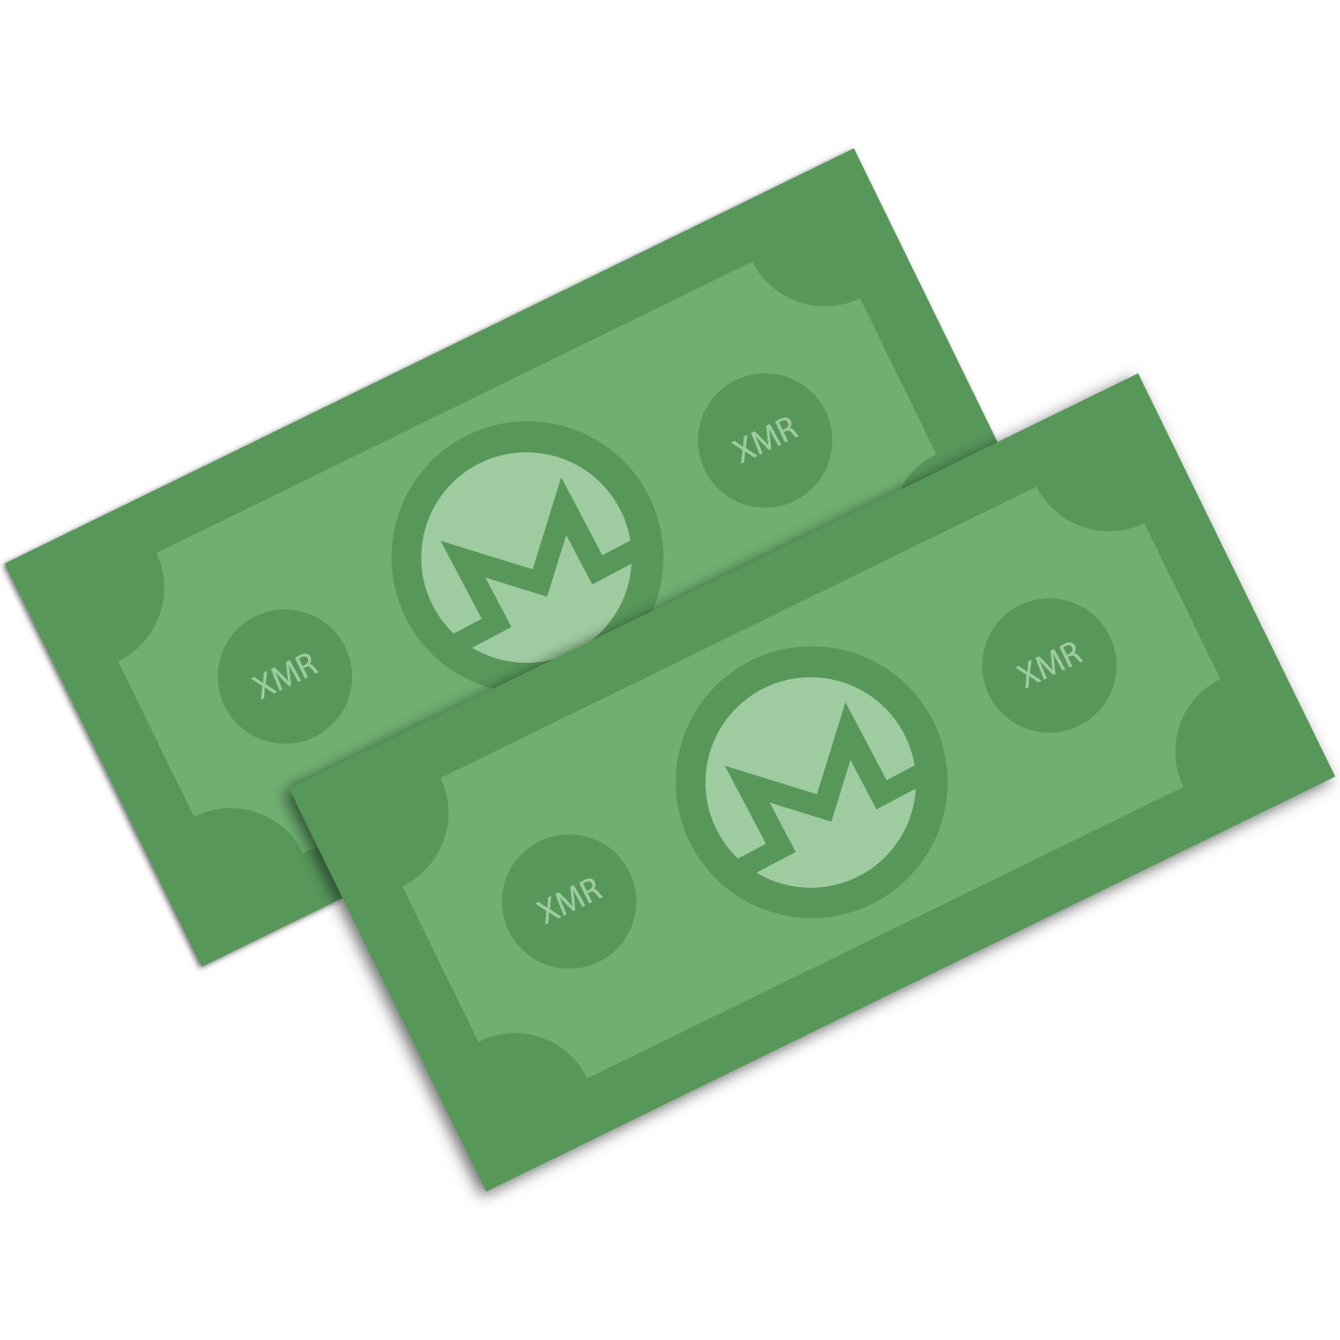
The Problem: Privacy is HARD

Slide 20


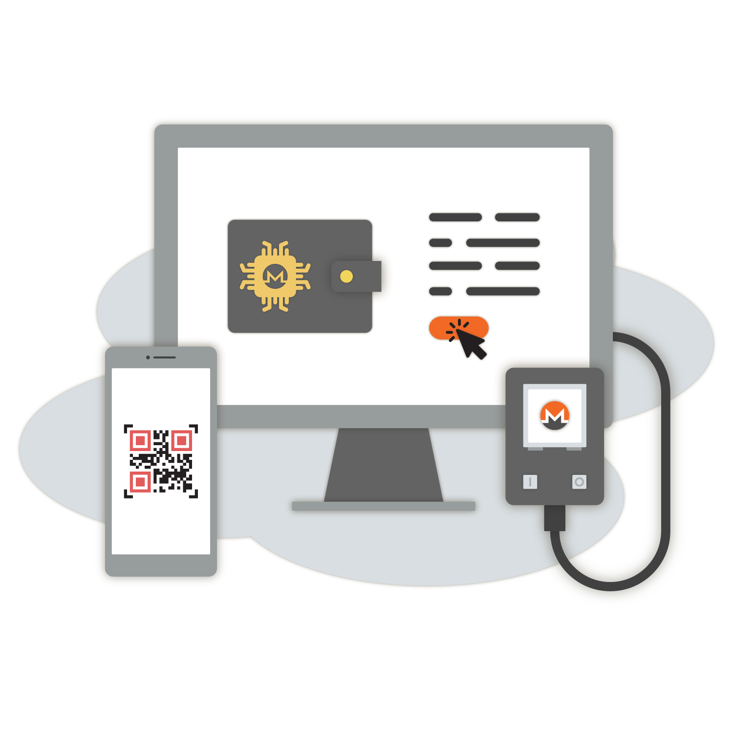
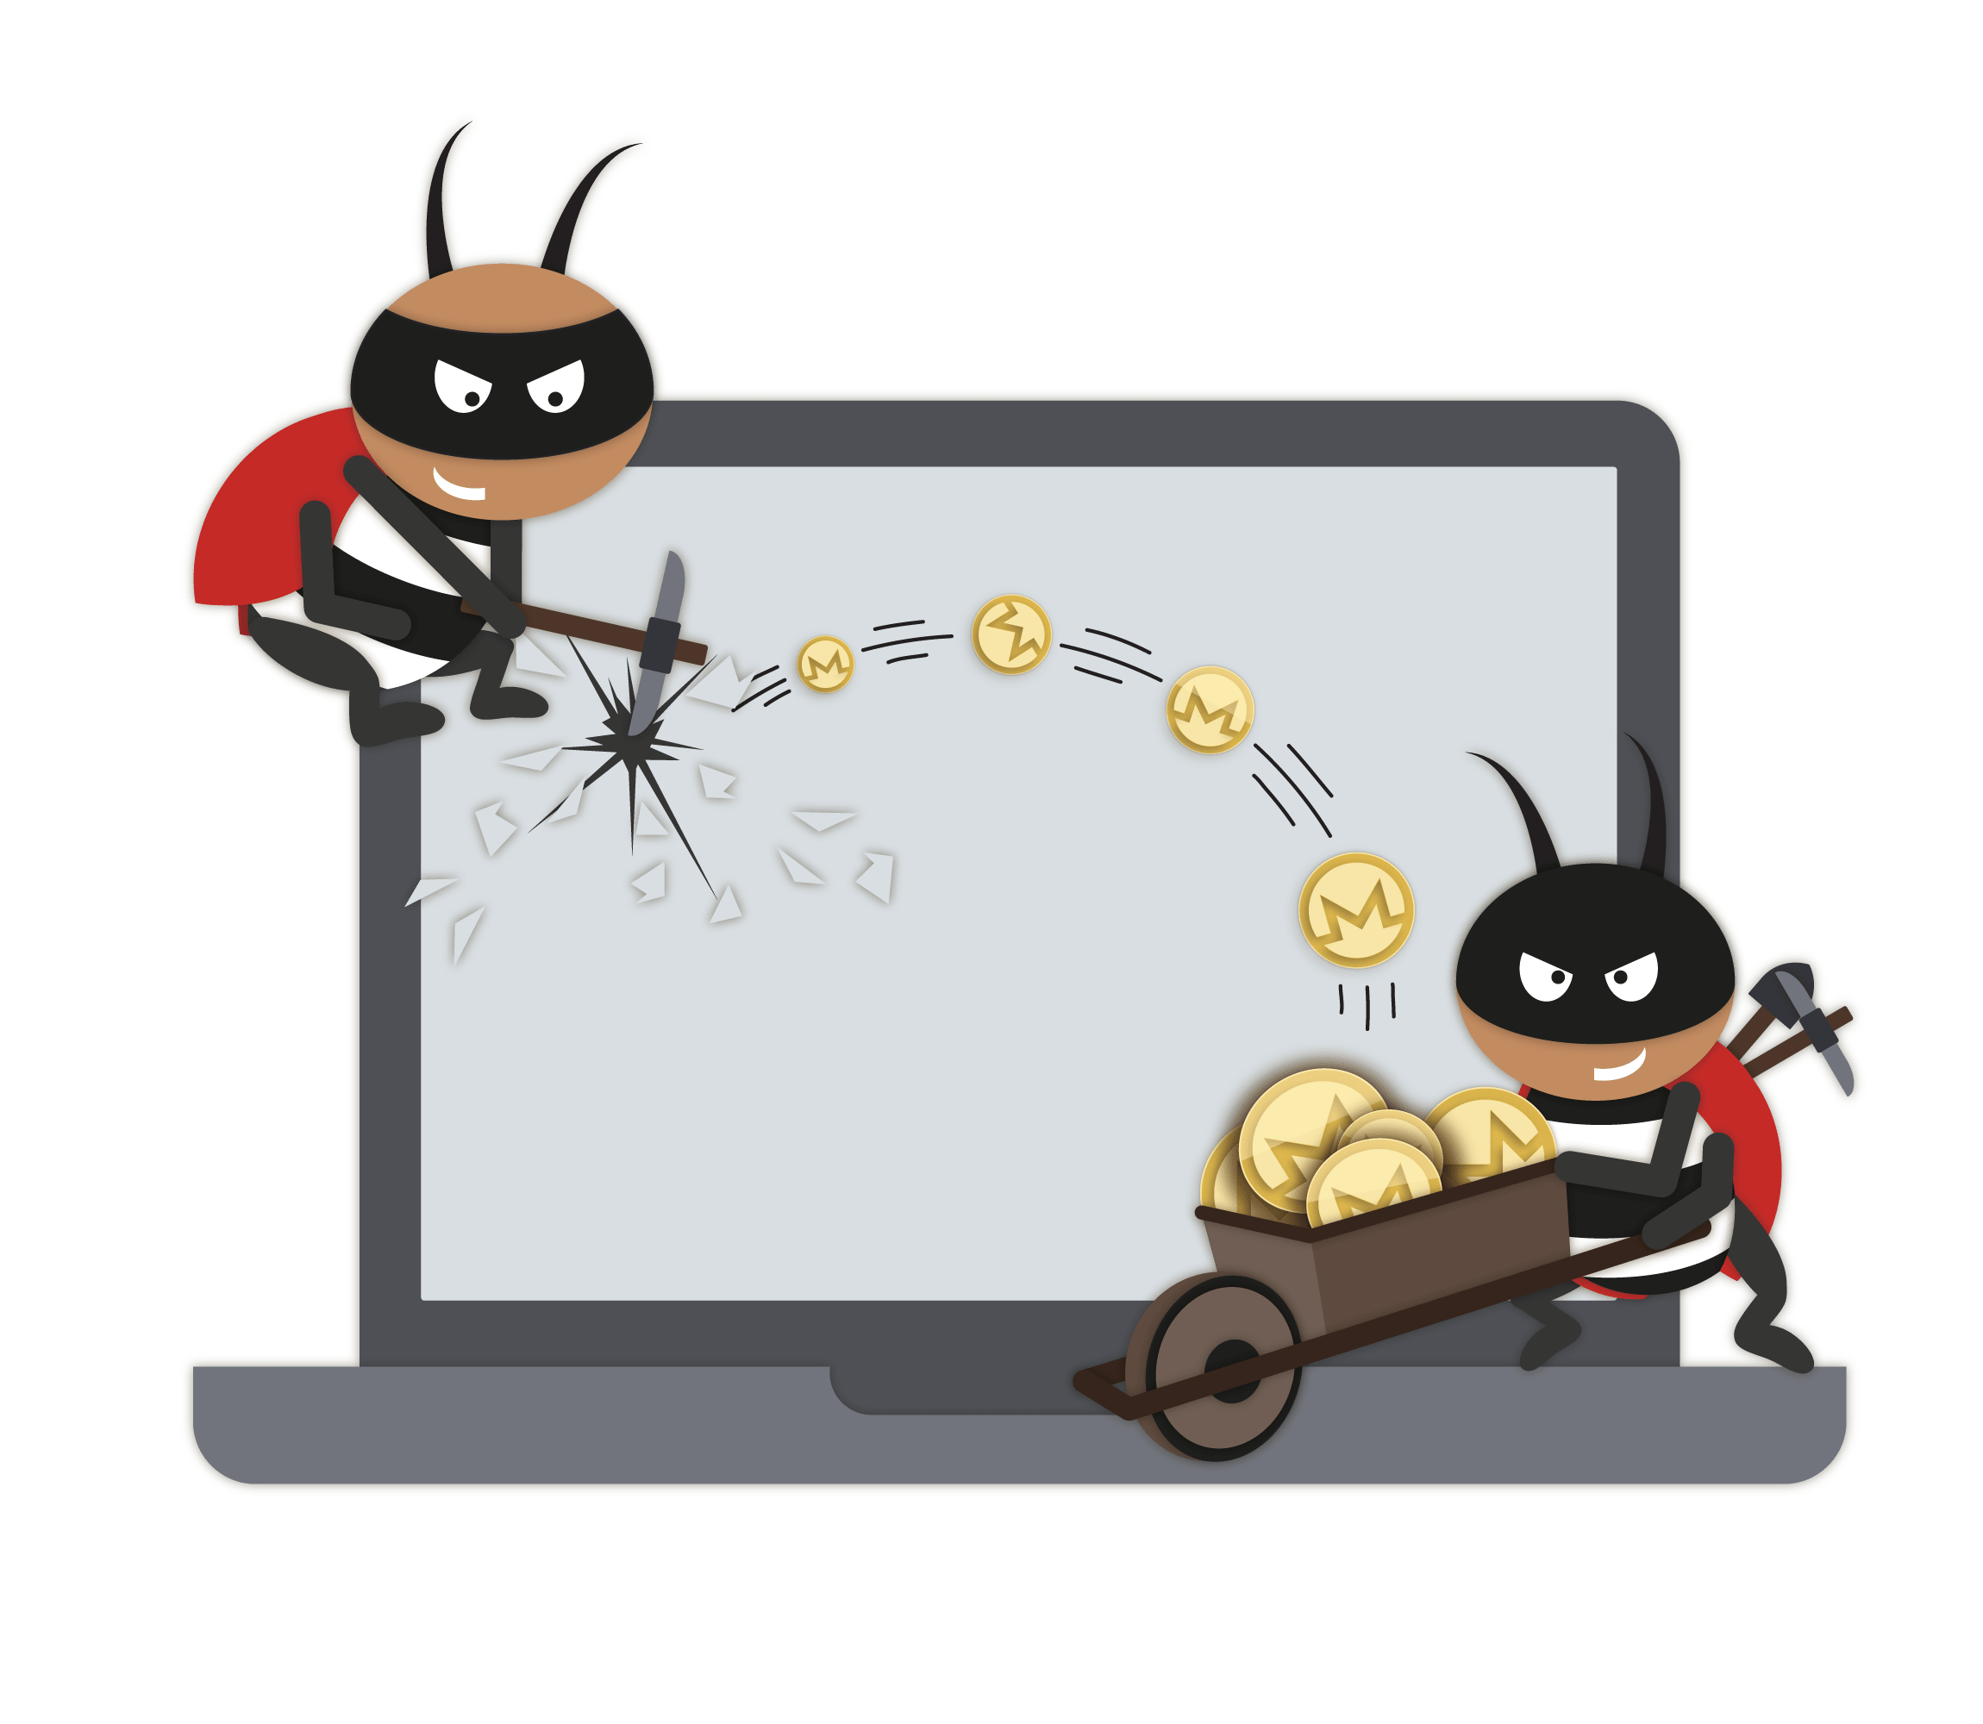
The Problem: Privacy is HARD
Notes:
There’s a huge amount of extra stuff to worry about.

Slide 21
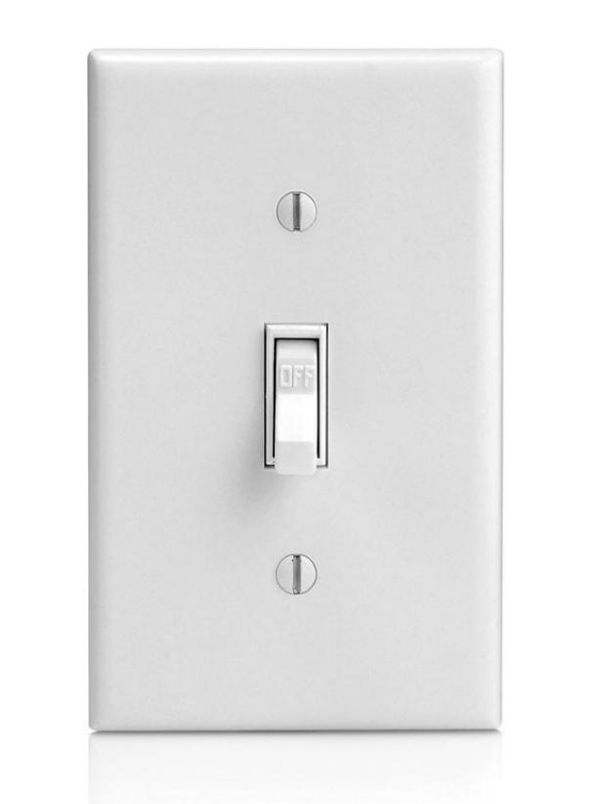
The Problem: Privacy is HARD
Privacy features may be on/off like a light switch, but reality is far more complicated, even for good privacy options.
Notes:
There’s a huge amount of extra stuff to worry about.

Slide 22
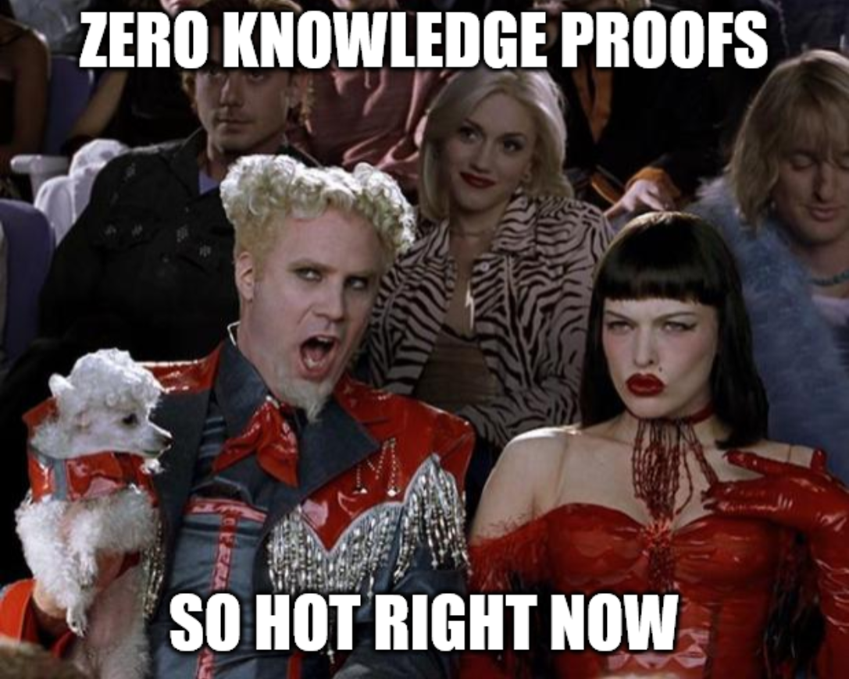
Zero-Knowledge Isn’t Perfect

Slide 23
Zero-Knowledge Isn’t Perfect
Zero-knowledge proofs are hot topics and sound amazing
Zero-knowledge proofs address specific problems, but they do so with varying levels of success and with different tradeoffs
Patching one hole doesn’t mean the other holes are magically patched
?

Slide 24
Fungibility is the Main Goal
Digital money where 1 BTC ≠ 1 BTC sucks
Inspecting funds before receiving or sending them sucks
Bitcoin is fungible-ish for the worst of both worlds:
Normal people accept it without thinking, assuming it’s fungible
Services audit and close accounts based on linked behavior
Normal, unsuspecting users at highest risk
Businesses still suffer from consequences of transparency
Optional privacy wallets are insufficient

Slide 25
Fungibility is the Main Goal
Without fungibility, we’ve created the same financial system as before
Surveillance companies function as payment processors to audit incoming funds for compliance purposes
Fungible assets avoid this problem
Prohibit
Accept with surveillance
Opt-In

Slide 26
Conclusion
Privacy is very difficult but an essential property
Individuals and businesses need privacy to transact
Privacy nuances are difficult to comprehend; the solution needs to be simple to use. Focus on the least-technical users.
We need to get away from the “efficiency first, privacy second” mindset
Without privacy, open blockchains will be used
primarily for surveillance purposes

Slide 27
Questions?
jehrenhofer@dvtrading.co
justin@ehrenhofer.org
@JEhrenhofer
Thanks to rehrar for designing many of the images used under the CC license

